Slide 1

Loyola Institute of Technology and Science
DEPARTMENT OF CSE
CS3811-PROJECT WORK

Slide 2
Federated Machine Learning for Secure and Adaptive
Fuels Theft Detection in Vehicles
ABDUL RAHMAN A (961222104001)
BALA SUBRAMANIAN M (961222104301)
SARAVANAN G (961222104048)
JENIN RAJ K (961222104023)
GUIDED BY
Mrs. A. MERRY IDA, M.E.,(Ph.D)
ASSISTANT PROFESSOR, COMPUTER SCIENCE AND ENGINEERING

Slide 3
CONTENT
Abstract
Justification for carrying out the project work
Literature review
Existing System
Proposed System
Tools for Implementation
Modules
Output/Results
References

Slide 4
ABSTRACT
Problem Statement: Fuel theft is a major economic issue, particularly for commercial fleets, as traditional detection methods are limited.
Proposed Solution: This project introduces a new hybrid system that uses Internet of Things (IoT) sensors and federated machine learning.
Project Goal: The aim is to create a secure, privacy-friendly, and flexible solution for detecting fuel theft in real-time.
Methodology: The system will learn consumption patterns and spot anomalies, avoiding a reliance on fixed thresholds which are often unreliable.
Key Advantage: By learning consumption patterns and detecting anomalies, the system will offer a more effective solution for real-time fuel theft detection.

Slide 5
JUSTIFICATION FOR CARRYING OUT THE PROJECT WORK
The project aims to revolutionize college transportation by ensuring student safety and punctuality through real-time bus tracking and proximity notifications.
Leveraging Google API's advanced features, the Android app enhances accuracy and efficiency, optimizing route planning and minimizing travel times.
With this technology, we empower students to make informed travel decisions and administrators to manage transportation resources effectively.
This project aligns with our commitment to innovation and providing a seamless transportation experience for all stakeholders.

Slide 6
LITERATURE REVIEW
[1] Siva Ramakrishna Pillutla, Anamika Lata, Praveen Maurya, Manish Kumar Singh, Rambabu Kusuma, "Design and Implementation of Vehicle Theft Prevention by Operating Fuel Injector", 2025 Third International Conference on Augmented Intelligence and Sustainable Systems (ICAISS). This paper addresses the critical issue of motor vehicle theft in India. The proposed solution is a system that combats theft by integrating fuel injector operation and scalable applications. By leveraging modern technologies such as face detection and GPS tracking, unauthorized vehicle access can be detected and thwarted in real-time. The system is implemented using Raspberry Pi, Arduino Nano, and Wi-Fi modules and includes a mobile application (Blynk App) for control and notifications. The prototype is designed to prevent unauthorized vehicle access and notify users of attempted thefts.
[2] Adhithya Madhavan, Santhosh Sivan J, Ayyarraja, Mrs. Sheela A, "Detecting Fuel Theft with Arduino", 2024 Second International Conference on Emerging Trends in Information Technology and Engineering (ICETITE). The paper introduces a Fuel Monitoring System to address the problem of fuel theft from parked cars, especially in areas without security or CCTV. The solution uses embedded system technology for real-time fuel level monitoring. The system strategically combines Arduino micro-controllers with GSM technology to provide timely owner notifications. In the event of fuel theft (when the fuel level decreases and the ignition is OFF), the system activates a buzzer for an audible alert and uses the GSM component to send a text message notification to the vehicle owner. The design is intended to be cost-effective and simple.

Slide 7
LITERATURE REVIEW
[3] Sangeeta Kurundkar, Sakshi Rathod, Ruta Sapate, Samruddhi Raut, Shantanu Khopade, "Vehicle Fuel Theft Detection System", 2024 International Conference on Sustainable Communication Networks and Application (ICSCNA). This research focuses on implementing a GSM-based vehicle fuel theft detection system to eliminate the common issue of fuel theft from vehicles, which causes significant financial loss. The method employs a level sensor to continuously track the fuel level in the tank. When the sensor detects a drop below a predefined threshold, the microcontroller (central processing unit) activates a buzzer to deter the thief and sends an SMS notice to the vehicle owner via a GSM modem. Crucially, the system is triggered only when the ignition key is withdrawn, ensuring the protection is active when the vehicle is unattended.
[4] VASANTH KUMAR, T.GIRISHCHOWDARY, PAVAN C, PRAVEEN D B, SATISH KUMAR B, "Vehicle Fuel Theft Detection and Monitoring System", 2024 JETIR May 2024, Volume 11, Issue 5. The primary goal of this article is the improvement of the car alarm security system by focusing on the prevalent issue of vehicle fuel theft. The project aims to digitize standard, analog fuel meters so they can display fuel values digitally (e.g., 1 liter, 1.5 liter). In the proposed system, if the fuel level is reduced during the ignition OFF condition, the owner receives an alert SMS using a GSM module, and a buzzer is used to alert the surroundings about the theft. This system typically utilizes a level sensor, a microcontroller (like Arduino UNO), and a GSM module for its functions.

Slide 8
EXISTING SYSTEM
Fixed-Threshold Detection : Many current systems rely on fixed thresholds to identify fuel theft. They trigger an alarm when a fuel level drops below a predefined point without considering normal consumption patterns or contextual data. This approach is often flawed because it can lead to false alarms and may not be effective against evolving theft techniques.
Reliance on Hardware for Detection : The majority of existing systems are heavily dependent on physical hardware components. These systems typically use an Arduino or similar microcontroller along with sensors like ultrasonic or capacitive to measure fuel levels. They often integrate a GSM module to send SMS alerts and a buzzer for a local audible alarm
Real-time Alerts : A common feature is the ability to provide real-time alerts to the vehicle owner. When a theft event is detected, systems use communication modules like GSM to send instant notifications, such as SMS messages or automated phone calls.
Lack of Privacy-Preserving Features : Traditional systems often send raw data, including vehicle location and fuel status, to a central server or mobile application. This creates a security risk and compromises user privacy, as sensitive information could be exposed or compromised if the central system is breached.
Limited Adaptive Capability : Existing systems are generally not designed to learn or adapt to new conditions or consumption patterns. They operate based on predefined rules, making them less effective at identifying new theft methods or differentiating between normal fuel use and an actual theft incident.

Slide 9
DISADVANTAGE
Complexity : The integration of federated machine learning adds a layer of complexity to the system, requiring sophisticated software and hardware compared to simpler models that use basic sensors and a GSM module.
Initial Development Cost : The initial development and implementation of a federated learning framework can be more expensive than creating a basic alert system due to the need for advanced algorithms like LSTM Autoencoder and Isolation Forest.
Dependence on Connectivity : While some existing systems can operate without constant internet, your system's collaborative learning aspect depends on a network connection to share model updates between devices and the central server.
Maintenance and Expertise : Implementing and troubleshooting a federated learning system requires a high level of technical expertise in both IoT and machine learning, making it less accessible for a typical user or a small business.
Potential for Performance Overhead : Training and updating machine learning models on individual devices could require significant processing power and energy, which might be a challenge for small, resource-constrained microcontrollers.

Slide 10
PROPOSED SYSTEM
Hybrid System Architecture: The system is designed as a hybrid solution that combines two key technologies. It integrates an IoT-based fuel monitoring system with a federated machine learning framework. (Federated Machine Learning , Embedded – C)
IoT for Real-time Monitoring: The system will use hardware such as an Arduino, an ultrasonic sensor. These components will enable continuous, real-time monitoring of a vehicle's fuel level and consumption patterns.
Federated Learning for Anomaly Detection: The core of the system's intelligence lies in its federated learning model. This model will learn to detect fuel theft as an anomaly by analyzing patterns from a fleet of vehicles without sending private data to a central server. (TensorFlow)
Privacy and Security Focus: The system's federated learning framework ensures that raw data remains on the vehicle. This approach prioritizes data privacy and security by preventing sensitive information from being exposed or compromised.

Slide 11
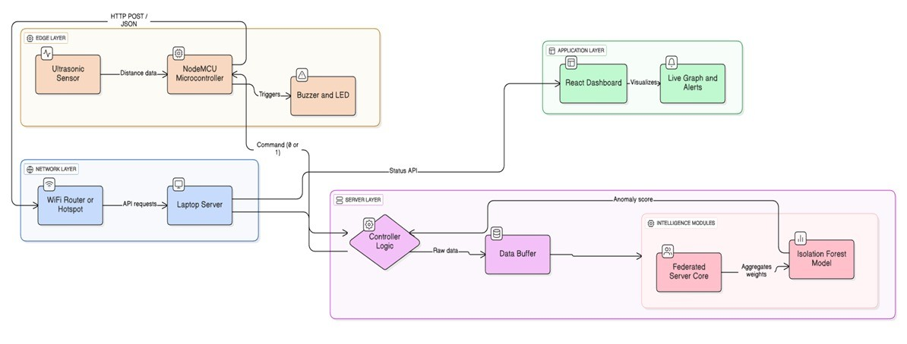
SYSTEM ARCHITECTURE

Slide 12
ALGORITHMS
Federated Averaging Algorithm (FedAvg) : By aggregating local model updates (statistical variance) from edge nodes instead of raw data, this algorithm updates the global theft detection model while preserving data privacy and minimizing bandwidth usage.
Isolation Forest Algorithm :This unsupervised learning algorithm detects fuel theft by isolating anomalies in the sensor data stream. It identifies data points that deviate significantly from the learned "normal" fuel consumption patterns, assigning them a high anomaly score.
Signal Processing & Debouncing Algorithm : This algorithm filters sensor noise and stabilizes readings by implementing a confirmation window. It triggers an alarm only when a significant fuel drop persists for consecutive readings, preventing false alarms caused by vehicle movement or vibrations.

Slide 13
ADVANTAGE
Improved Accuracy : By using machine learning to analyze consumption patterns instead of fixed thresholds, your system can significantly reduce false alarms and more accurately detect actual theft.
Adaptive to New Threats : The system's ability to learn from consumption patterns allows it to adapt and identify new or evolving theft techniques that might not be caught by traditional, rule-based systems.
Enhanced Data Privacy : The federated learning framework ensures that sensitive, raw data remains on the vehicle. This allows the model to learn from a large fleet without centralizing data, which is a major privacy advantage.
Collaborative Learning : By learning collectively from an entire fleet, the model can improve its detection capabilities more rapidly and effectively than a standalone system would.
Reduced Centralization Risk : Since raw data isn't sent to a central server, the system mitigates the risk of a single point of failure or data breach that could expose the information of an entire fleet.

Slide 14
TOOLS FOR IMPLEMENTATION
Software Tools
Programming : Python 3.xx ,Embedded-C
Deep Learning Libraries: Scikit Learn, Keras, PyTorch
Machine Learning Algorithms: Isolation Forest
Federated Learning: TensorFlow Federated (TFF)
Frontend: React.js,Tailwind CSS
Backend: FLASK ,Postman
IDE / Editor: VS Code, Arduino IDE
Hardware Tools
NodeMCU Esp8266
Ultrasonic sensor
LED,Buzzer
Jumper wires
USB Cable

Slide 15
MODULES
IoT Sensing and Data Acquisition
Secure Connectivity and API Gateway
Federated Learning and Anomaly Detection CoreAuthentication
Intelligent Alerting and Actuation System
Real-Time Monitoring Dashboard

Slide 16

OUTPUT/RESULTS
The user interface for the Secure Fuel Monitoring System is designed with a high-contrast "Cyber-Security" dark theme to ensure clarity and professional appeal. The dashboard features a dynamic Live Sensor Feed line chart that visualizes fuel level fluctuations in real-time. Key visual elements include color-coded status cards that instantly transition from Green (Normal) to Red (Theft Detected) or Grey (Offline) based on server feedback. This intuitive layout ensures that complex Federated Learning inputs are translated into clear, actionable insights, allowing administrators to identify and respond to fuel theft incidents immediately.

Slide 17
USER INTERFACE
The user interface (UI) for the Secure Fuel Theft Detection System is built using React.js and Tailwind CSS, designed to provide a seamless, real-time monitoring experience for fleet administrators and security personnel.
Designed with a high-contrast "Cyber-Security" dark theme, the dashboard focuses on clarity and speed, ensuring that critical alerts (like theft detection) grab the user's attention immediately through dynamic color changes (Green to Red).

Slide 18
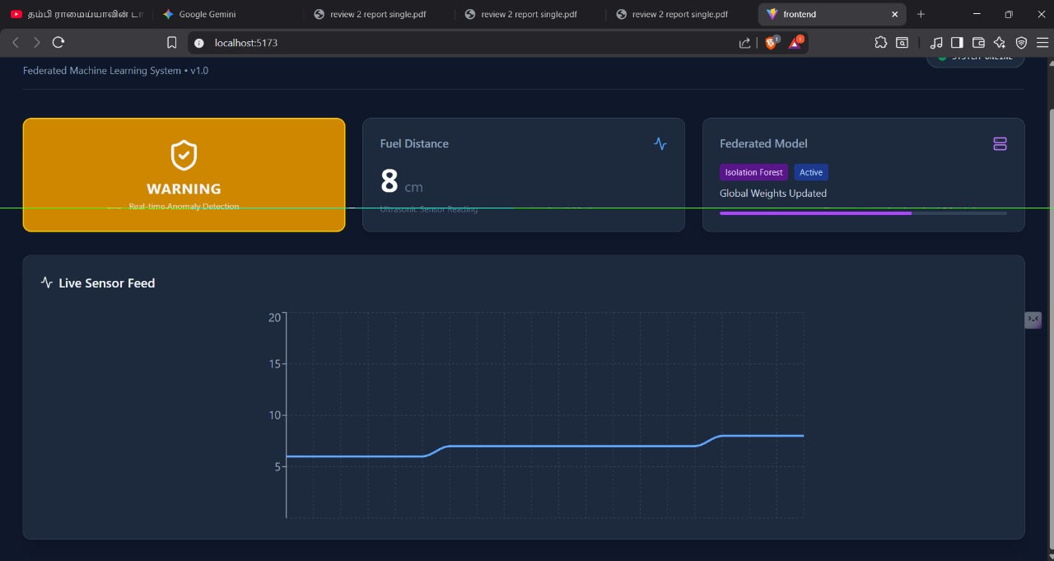
WEB INTERFACE
The web interface for the Fuel Theft Detection System is developed using React.js and Tailwind CSS, providing a responsive and high-performance dashboard for real-time monitoring.
It features a dynamic line chart powered by Recharts, which visualizes live fuel level data received from the NodeMCU, allowing administrators to track consumption trends instantly.
Key components of the Web Interface include:
Live Status Cards: Visual indicators that change color (Green/Red/Grey) based on the system state (Normal, Theft, Offline).
Alert System: Immediate visual warnings ("THEFT DETECTED") displayed prominently when an anomaly is confirmed.
Accuracy Metric: A real-time display of the Machine Learning model's confidence score against the logical ground truth.

Slide 19
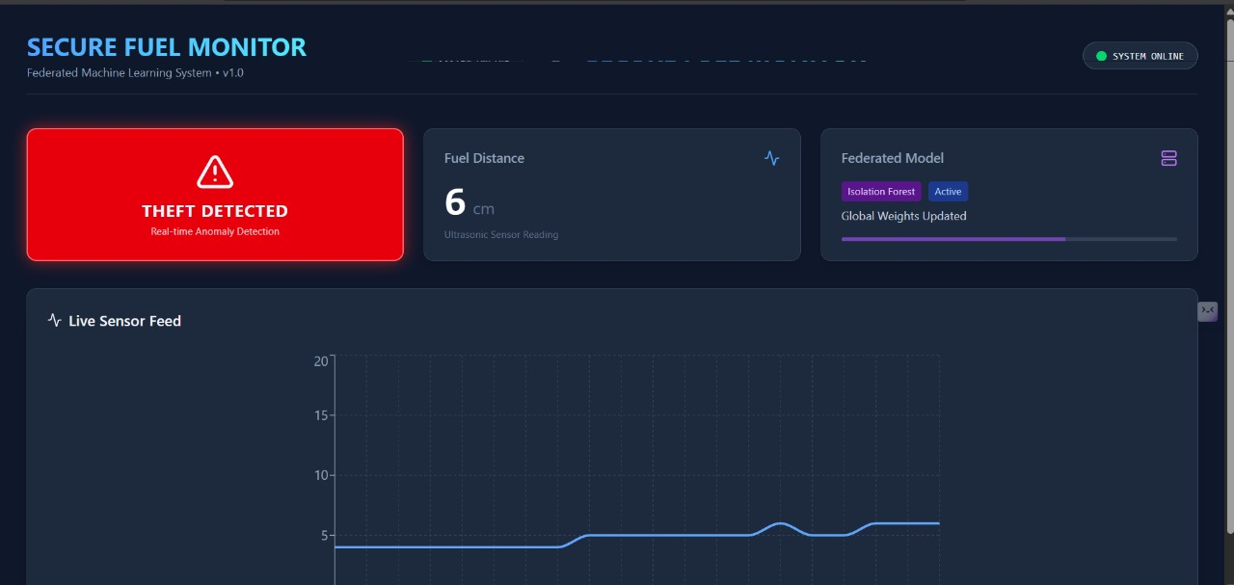
LIVE GRAPH INTERFACE
Real-Time Visualization: The interface features a dynamic line chart powered by Recharts, rendering live fuel level data with millisecond latency.
Trend Monitoring: By visualizing the last 20 sensor readings, the graph allows administrators to instantly distinguish between gradual consumption and sudden drops indicative of theft.
Zero-Lag Updates: The system employs an efficient polling mechanism that refreshes the visualization every second, ensuring the display is always synchronized with the physical hardware.

Slide 20
ADDITIONAL FEATURES
Smart Connectivity Monitoring: The system features an automated "Heartbeat Check" mechanism. If the Edge Node (NodeMCU) loses power or disconnects for more than 5 seconds, the server instantly updates the dashboard status to "OFFLINE" (Grey), ensuring administrators are never misled by stale or frozen data.
Intelligent Debouncing Logic: To distinguish between genuine theft and vehicle vibrations (road bumps), the system utilizes a "Confirmation Window." The hardware alarm is only triggered if an anomaly persists for three consecutive readings, significantly reducing false positives compared to traditional sensors.
Privacy-First Architecture: By implementing a Federated Learning simulation, the system is designed to prioritize data privacy. It demonstrates a capability where sensitive raw fuel data can be processed locally at the edge, with only statistical model updates transmitted to the central server, minimizing cyber-security risks.

Slide 21
REFERENCES
[1]. Madhusudhana Rao, G., et al. "Fuel Theft Detection System with Automated Calling and Alert Using GSM." International Journal of Innovative Research in Science, Engineering and Technology, 2024.
[2]. Chaudhari, Durvesh S., et al. "Fuel Monitoring System Using IoT Device." International Research Journal of Modernization in Engineering Technology and Science, 2024.
[3]. Pillutla, Siva Ramakrishna, et al. "Design and Implementation of Vehicle Theft Prevention by Operating Fuel Injector." Third International Conference on Augmented Intelligence and Sustainable Systems (ICAISS), 2025.
[4]. Sharma, Rashika A., et al. "IoT Based Fuel Tank Monitoring System." International Research Journal of Modernization in Engineering Technology and Science, 2025.
[5]. Deekshitha, R., et al. "Smart Fuel Level Monitoring and Alerting System Based on IoT." Futuristic Trends in IOT, 2024.
[6]. Madhavan, Adhithya, and Sheela A. "Detecting Fuel Theft with Arduino." Second International Conference on Emerging Trends in Information Technology and Engineering (ICETITE), 2024.
[7]. Kurundkar, Sangeeta, et al. "Vehicle Fuel Theft Detection System." International Conference on Sustainable Communication Networks and Application (ICSCNA), 2024.
[8]. Mengstie, Berhanu Abnet, and Eden Aragaw Addisu. "Evaluation of Fuel Theft Prevention System with Integrated Sensors." SSRN, 2024.
[9]. Kumar, Vasanth, et al. "Vehicle Fuel Theft Detection and Monitoring System." Journal of Emerging Technologies and Innovative Research, 2024.
[10]. Deepika and Sneha H. R. "Smart Fuel Theft Detection and Monitoring System Using IoT with GPS and GSM Integration." Journal of Emerging Technologies and Innovative Research (JETIR), 2025.

Slide 22
THANK YOU

